Slide 1
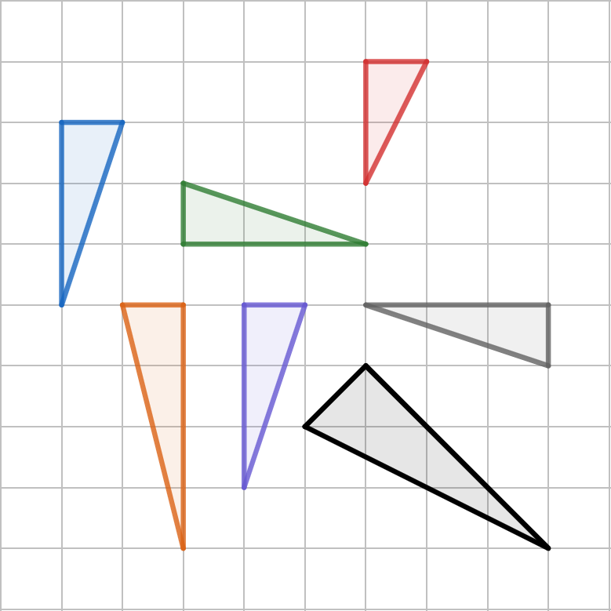
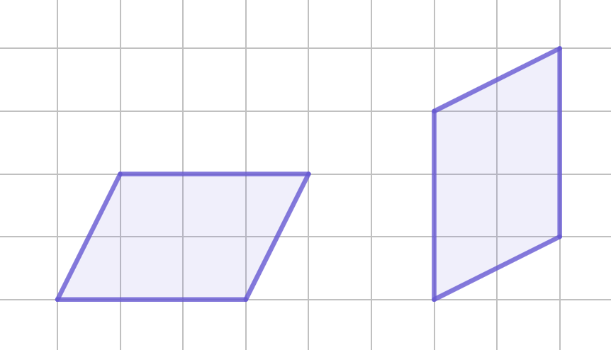
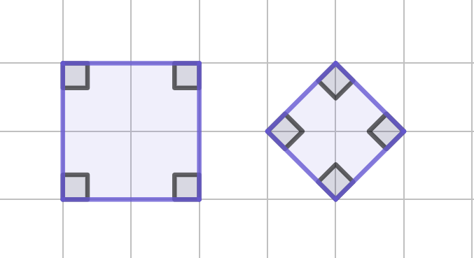
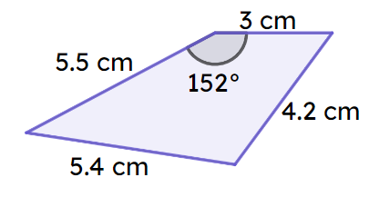
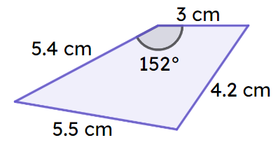
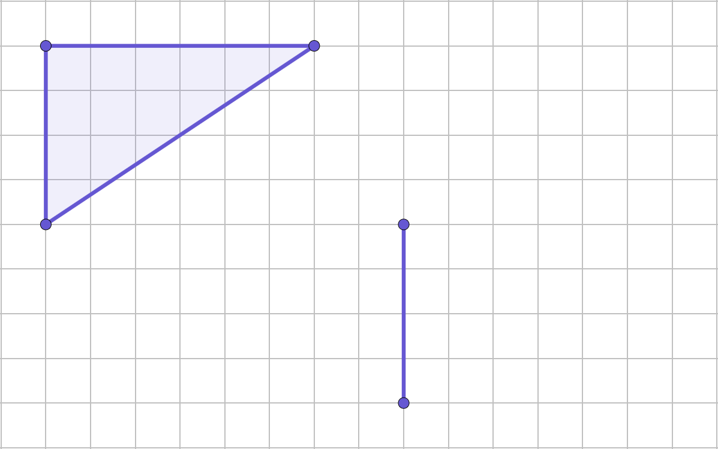
Checking understanding of basic transformations
Task A: Congruency
1) Which of these triangles are congruent?
C
A
B
D
E
F
G
2) Are the two shapes congruent or not? If not, why not?
a)
b)
c)
Mark where you could put the third vertex to make the two triangles congruent. One edge has been given.

Slide 2
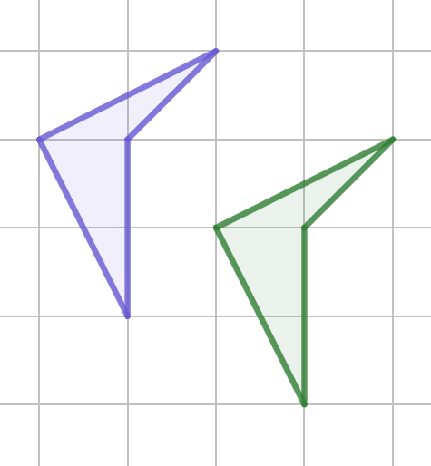
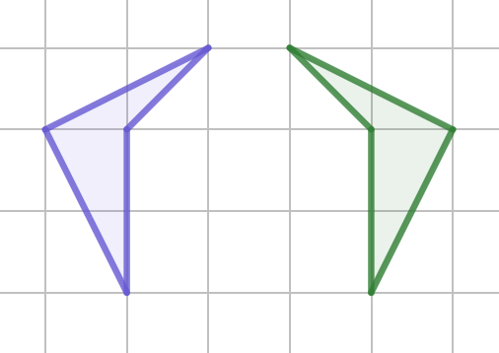
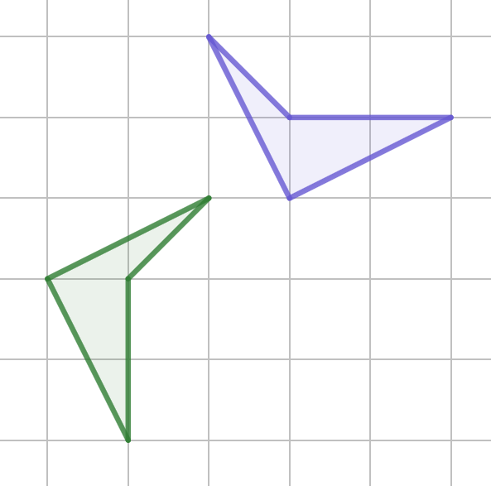
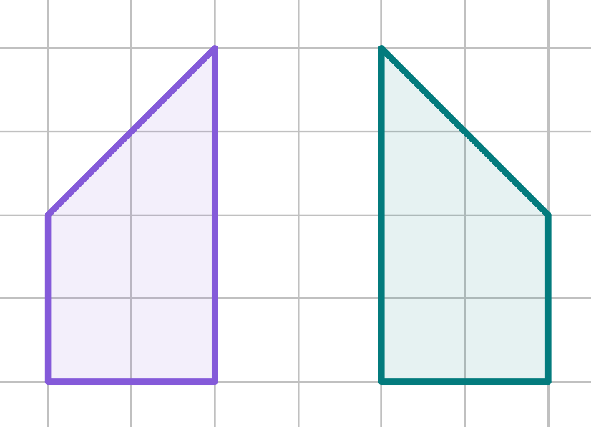
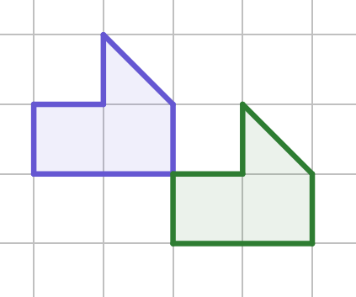
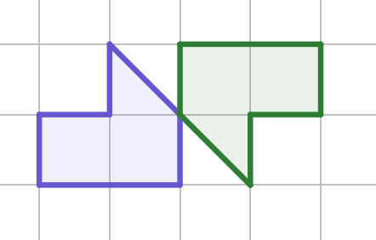
Checking understanding of basic transformations
Task B: Describing changes
1) Match the descriptions to the correct figure.
The image is congruent but mirrored.
The image is congruent and has the same orientation as the object.
The image is congruent but the orientation has changed from the object.
Complete the table regarding the properties of the image compared to the object and then use it to write a description.
Property | Changed - yes/no?
Orientation
Lengths
Position
Angles
Mirrored
3) Write a description for the two transformations.
b)
Mathematics in Education and Industry.
v2.1

